Slide 1
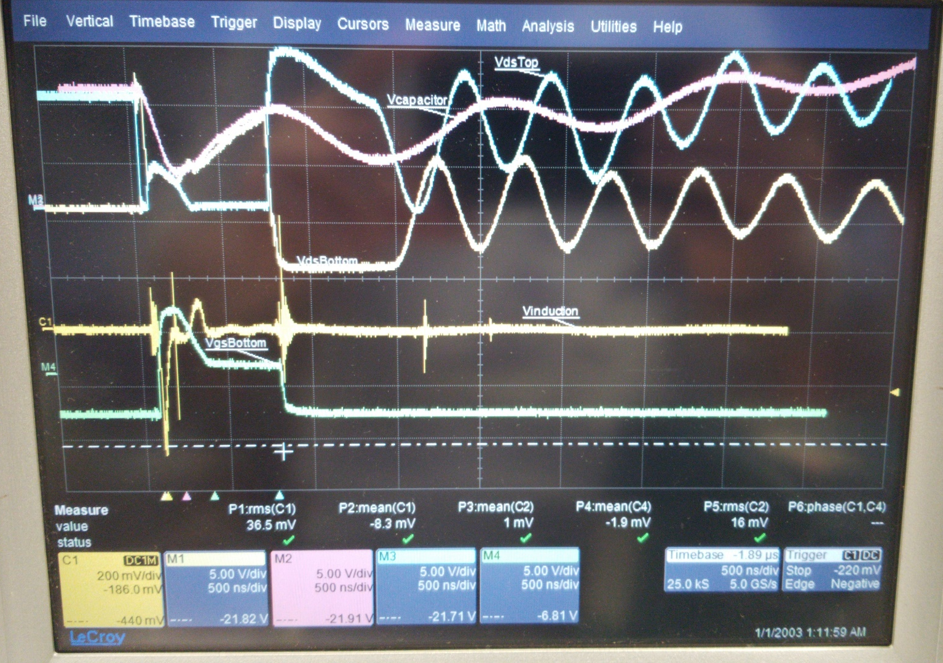
Short Circuit Protection (SCP) Mechanism
~0.5V Threshold
Single Bridge Configuration
An example view under 10V

Slide 2
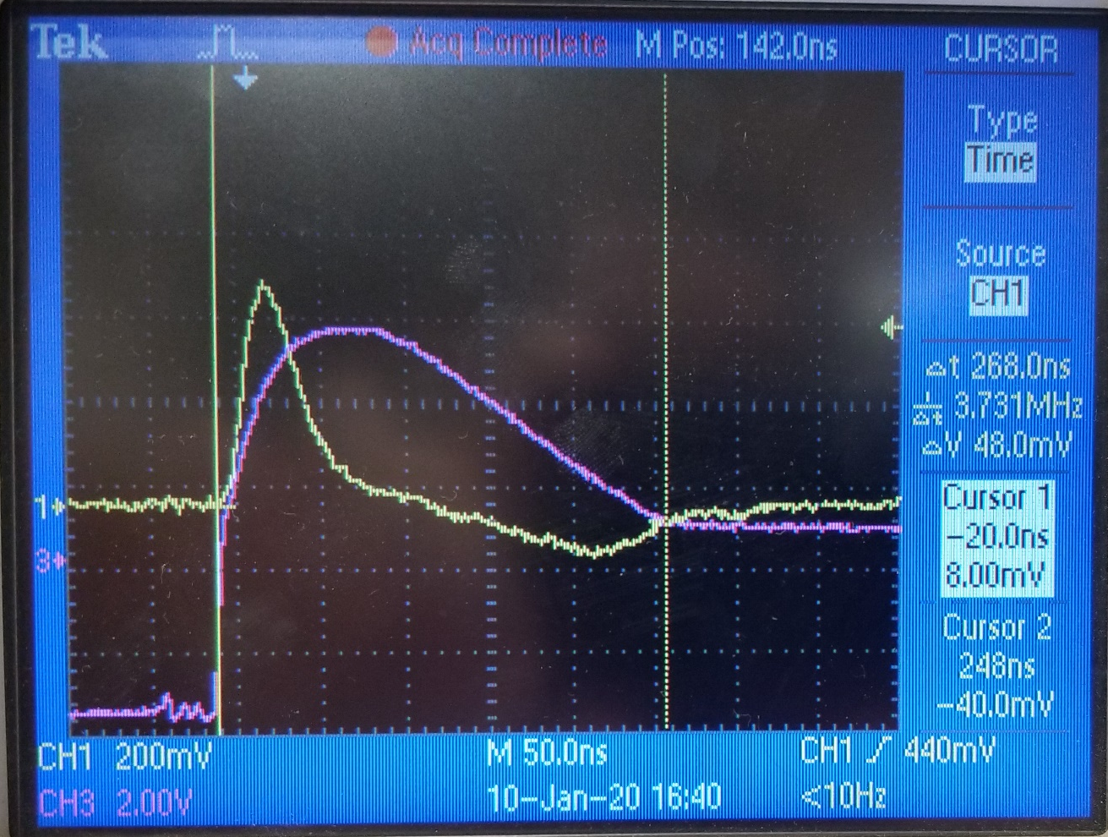
Short Circuit Protection (SCP) Mechanism
Timings of self-triggered SCP mechanism
SC start – SC sense: 30 nsec
SC sense – Start of discharge: 68 nsec
Start of discharge – End of discharge: 170 nsec
In total
SC start – End of discharge: 268 nsec
Full time scope of a SCP Mechanism
Yellow -> Induced voltage
Pink -> Gate-source voltage

Slide 3
Single Bridge DPT Results

Slide 4
Single Bridge DPT Results
Control switch waveforms
No DC waveforms are 0.5V lower than actual
Non-problematic noise

Slide 5
Single Bridge DPT Results
Control switch waveforms
DC Voltage | Overshoot Level
25 | 36 (44%)
50 | 68 (36%)
75 | 96 (28%)
100 | 142 (42%)

Slide 6
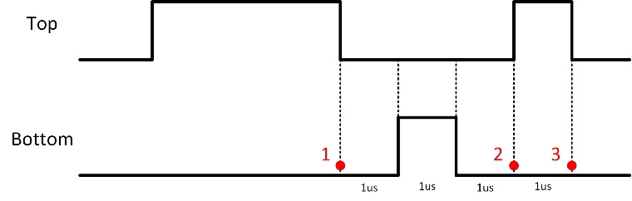
Single Bridge DPT Results
Synchronous switch waveforms
No DC waveforms are 0.5V lower than actual
Unintended rise on gate-source voltage: False turn-on (Safe)
Short-circuit detection (Probably False)

Slide 7

Single Bridge DPT Results
Synchronous switch waveforms
High inductance, alone capacitance?
Quite interesting discharge
What about the crest factor of current?
$$X_{c}=\frac{I_{peak}}{I_{rms}}$$

Slide 8
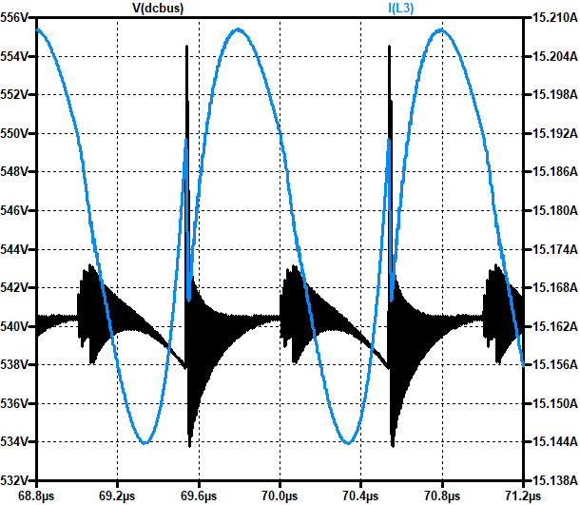

Buck Converter Simulation
Buck converter is not affected that much because crest factor of current is quite low
Even though the peak current is higher for a switching period of a buck converter, the RMS current is high. For DPT case, current is not drawn continously, so the RMS value is extremely low. High amount of current is drawn for a very short period.
$$\sim 2.5V$$

